Slide 2
AI In Power Apps – Perform Entity Extraction for your Data
Dhruvin Shah

Slide 3




Dhruvin Shah
Power Platform Specialist and Office 365 Developer
I’m working as Power Platform Specialist (P Factor – Power BI, Power Apps, Power Automate and Power Virtual Agents) and Sr. Office 365 Developer in one of the reputed company at Ahmedabad, Gujarat.
Very Active Blogger and YouTuber having 100+ Articles and 300+ Tech Videos.
I’m Three(3) Times C# Corner MVP.
dhruvinshah16@gmail.com
https://tinyurl.com/uak32tg
@Dhruvinshah16
https://www.facebook.com/learn2All/

Slide 4
Overview
Overview of Entity Extraction AI Model
Prepare
Prepare CDS model for Entity Extraction
Build
Build Entity Extraction AI Model
Train and Publish
Train and Publish Entity Extraction AI Model
Consume
Consume Prediction AI Model to Power Apps using Power Automate

Slide 5
Overview of Entity Extraction AI Model

Slide 6
What is Entity Extraction AI Model?
Recognize Data from given Text
Transform Unstructured Data to Structured Data

Slide 7

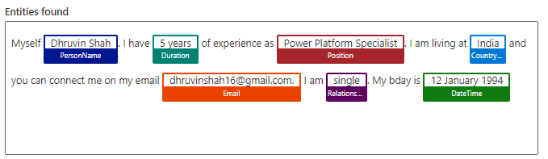
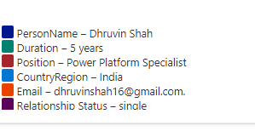
Example
Myself Dhruvin Shah. I have 5 years of experience as Power Platform Specialist. I am living at India and you can connect me on my email dhruvinshah16@gmail.com. I am single. My bday is 12 January 1994

Slide 8
Real – Life Use Case
Recruitment Agency/ HR Portal
Recruitment Agency receiving lots of candidate information in a form of Email or chat.
Their Business model will require only specific values from the unstructured data which they had received.
So, Entity Extraction AI Builder recognize useful information from data and convert to structured machine-readable data.

Slide 9
Important Points to Remember for Entity Extraction
Train the data from Common Data Service Entity.
Languages Supported: English, Chinese-Simplified, French, German, Italian, Spanish, and Portuguese
Length of Document should not be exceeding more than 5000 characters.
Need to provide at least 10 examples for your data.

Slide 10
Prepare CDS Data Model

Slide 11
Prepare Entity Extraction AI Model

Slide 12
Consume Entity Extraction AI Model to Power Apps Using Power Automate

Slide 13
Follow on all Social Media
Whatsapp
+91 9537981467
Twitter
@Dhruvinshah16
Facebook
https://www.facebook.com/learn2All/
YouTube
LinkedIN
Blogger
https://www.youtube.com/user/dhruvin953798
https://tinyurl.com/w94pcxs
https://tinyurl.com/uak32tg

